Slide 1

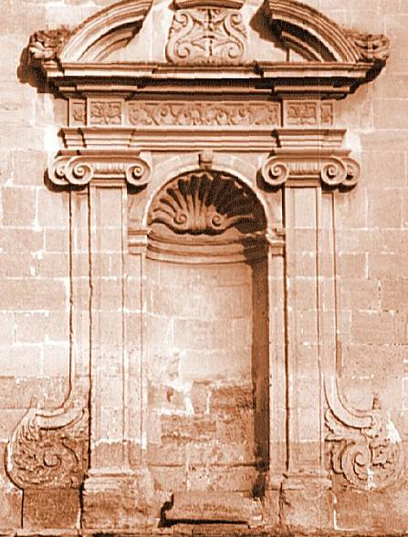
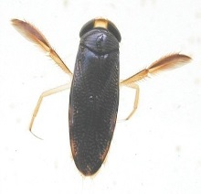
Metacommunities:

Slide 2
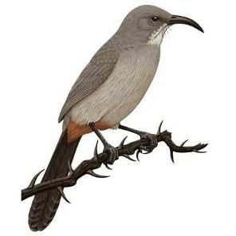
A Brief History of the (Ecological) Niche Concept
Grinnell (1917)→Hutchinson (1957)

Slide 3
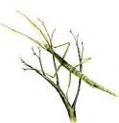


A Brief History of the (Ecological) Niche Concept
Niche
Factor Y
Factor Z
Factor X
Grinnell (1917)→Hutchinson (1957)

Slide 4

A Brief History of the (Ecological) Niche Concept
Niche
Factor Y
Factor Z
Factor X
Grinnell (1917)→Hutchinson (1957)

Slide 5
A Brief History of the (Ecological) Niche Concept
Niche
Factor Y
Factor Z
Factor X
Grinnell (1917)→Hutchinson (1957)

Slide 6
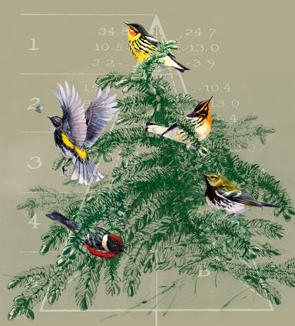
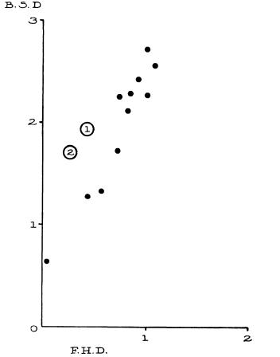
Ecological Niches as the Basis for Coexistence/Diversity
Bird Diversity
Foliage Height Diversity

Slide 7
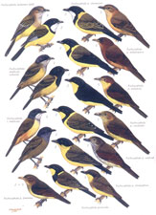
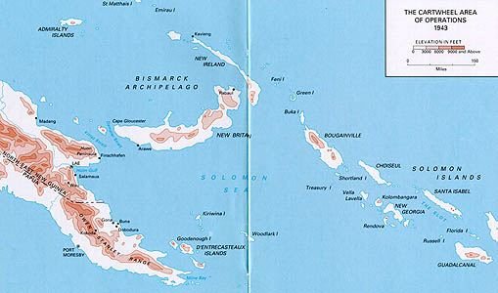
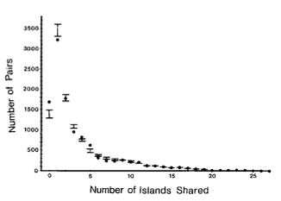
Diamond’s ‘Assembly Rules’

Slide 9
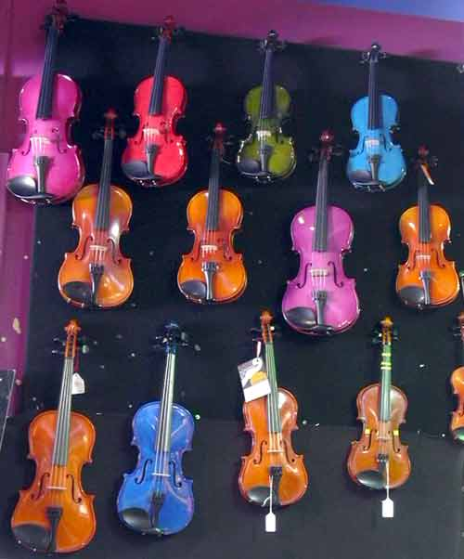
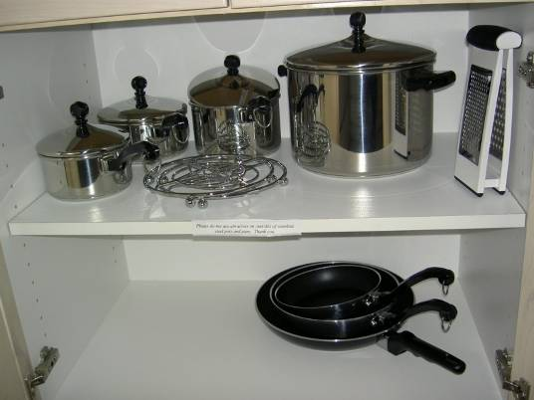
-D. Simberloff

Slide 10
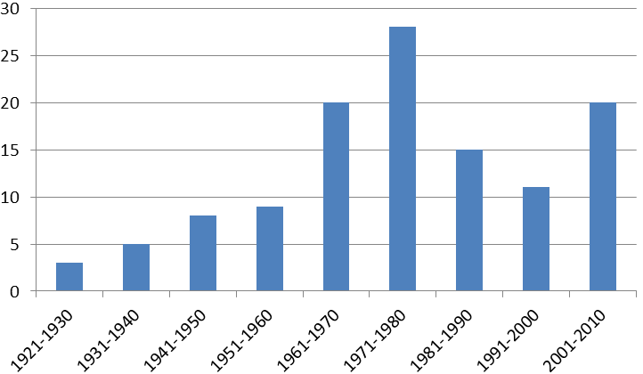
‘Ecological Niche’ concept through time
Hutchinson
MacArthur
Percentage of papers
Grinnell
Elton
Percentage of papers in Ecology using ‘niche’

Slide 11
‘Ecological Niche’ concept through time
Simberloff, Strong et al.
Hutchinson
MacArthur
Niche vs. Neutral
Percentage of papers
Grinnell
Elton
Percentage of papers in Ecology using ‘niche’

Slide 12
Species can’t be too similar……
….but, they also can’t be too different
~Chesson’s (2000) General Theory of Coexistence
Coexistence depends on the ratios of:
→Stabilizing Mechanisms (Can’t be too similar)
→Equalizing Mechanisms (Can’t be too different)
Possible Coexistence
Possible Coexistence
Resource A
Resource B

Slide 13
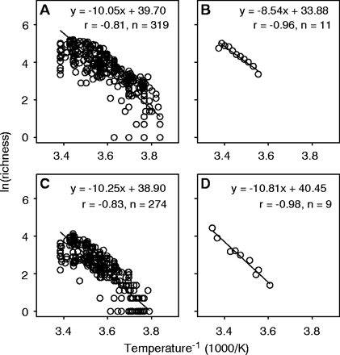
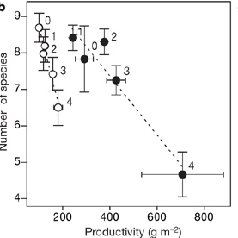
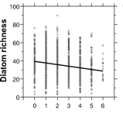
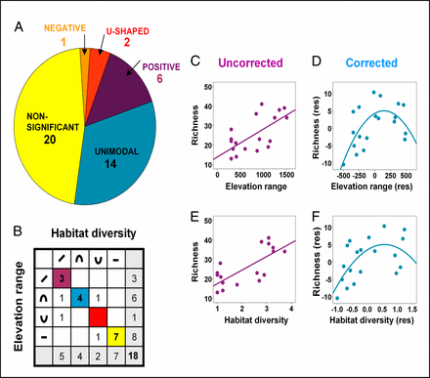
Niches still at the forefront of biodiversity studies…..
Allen et al. 2002 Science
Harpole and Tilman 2007 Nature
Passey 2008 PNAS
Allouche et al. 2012 PNAS

Slide 14
Even classic coexistence stories had a spatial component
Gause 1934

Slide 15
Even classic coexistence stories had a spatial component

Slide 16

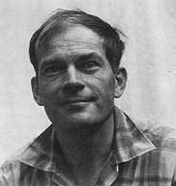
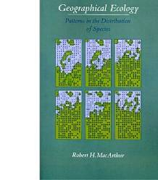
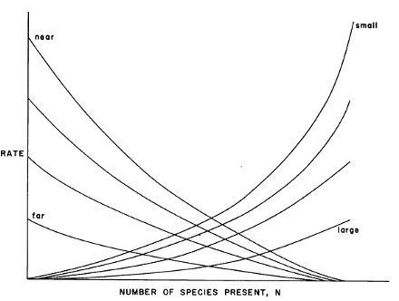
“MacArthur’s Paradox” and the Metacommunity
Local perspective
Regional perspective
Original Resource Ratio Model
Basis for Niche Theory
Theory of Island Biogeography:
Basis for Neutral Theory

Slide 17
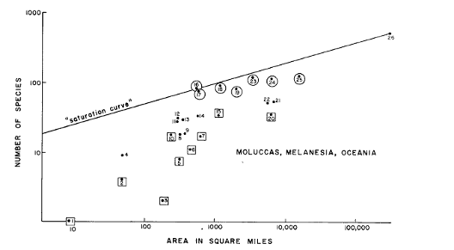
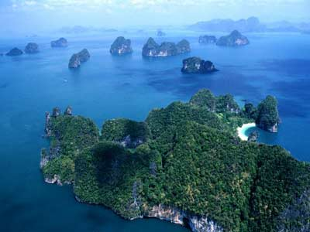
The role of space…
MacArthur and Wilson 1963

Slide 18
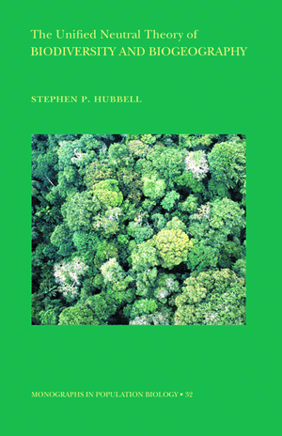
Unified Neutral Theory:
A successful, if not simplistic, metacommunity theory
Are species everywhere they could be?
What regulates species commonness and rarity?
Are communities stable or ever-changing through time?
The ‘Neutral Theory’ provided an alternative framework to more traditional ‘Niche Theory’ that appeared to predict a number of commonly observed patterns in nature

Slide 19
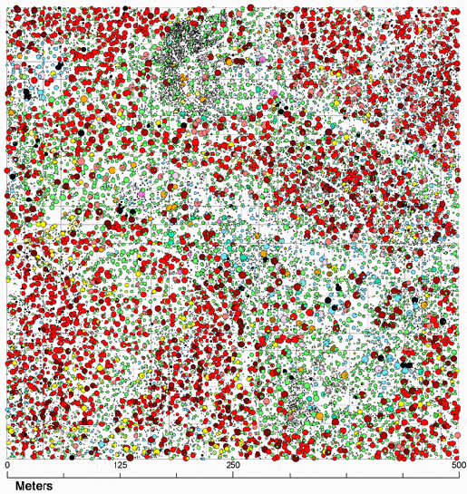
What influences spatial aggregation? How do we quantify it?

Slide 20
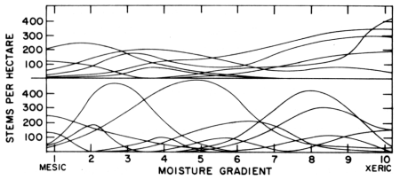
Whittaker’s concept of β-diversity
Low β-diversity
Siskiyou Mountains, Oregon
Santa Catalina Mountains, Arizona
High β-diversity
A deterministic “niche-based” perspective

Slide 21
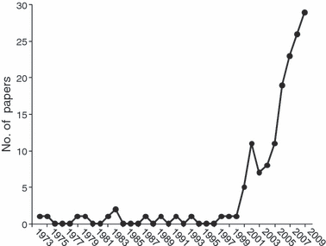
The β-diversity concept through time
Anderson, et al. 2011 Ecology Letters

Slide 22
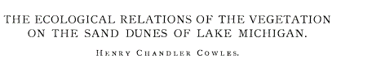
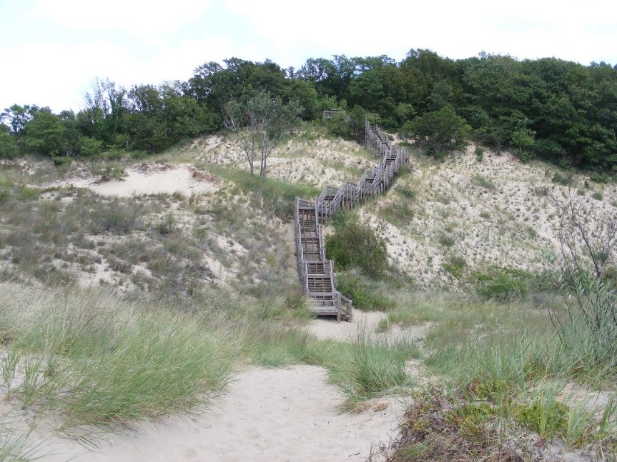
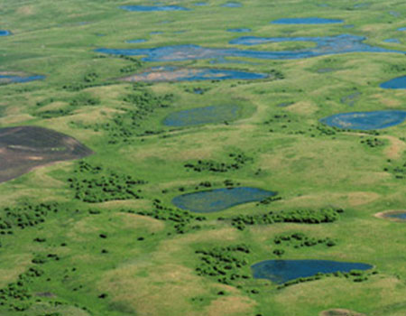

Just How Predictable are Communities?
… Tansley, Gleason, Cooper, Egler, others
"The vegetation of an area is merely the resultant of …the fluctuating and fortuitous immigration of plants and an equally fluctuating and variable environment”
…Clements, Phillips, others
Climax communities and super-organisms
Gleason 1926

Slide 23
Using β-diversity to Disentangle Niche vs. Drift/Dispersal Limitation
Regional Species
Pool
β-
diversity
Species Sorting
(Niche)
A B C D
A B C D E
F G H I J
D E F G
G H I J
Regional Species
Pool
β-
diversity
A B C D
A B C D E
F G H I J
Stochastic assembly
(Drift)
D E F G
G H I J

Slide 24
Space vs. environment: What can β-diversity tell us?
Neutral Model
Niche Model
Beta-diversity
Beta-diversity
Spatial gradient
Spatial gradient
Environmental gradient
Environmental gradient
Chase et al. 2005

Slide 25
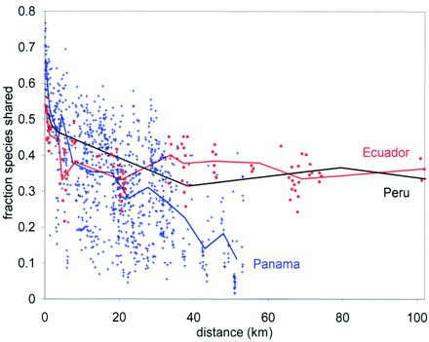
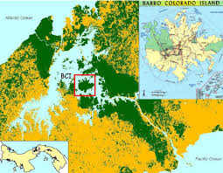
Beta diversity in tropical forests: Lots of ‘unpredictability’ (i.e., drift)
Condit et al. 2001 Science

Slide 26
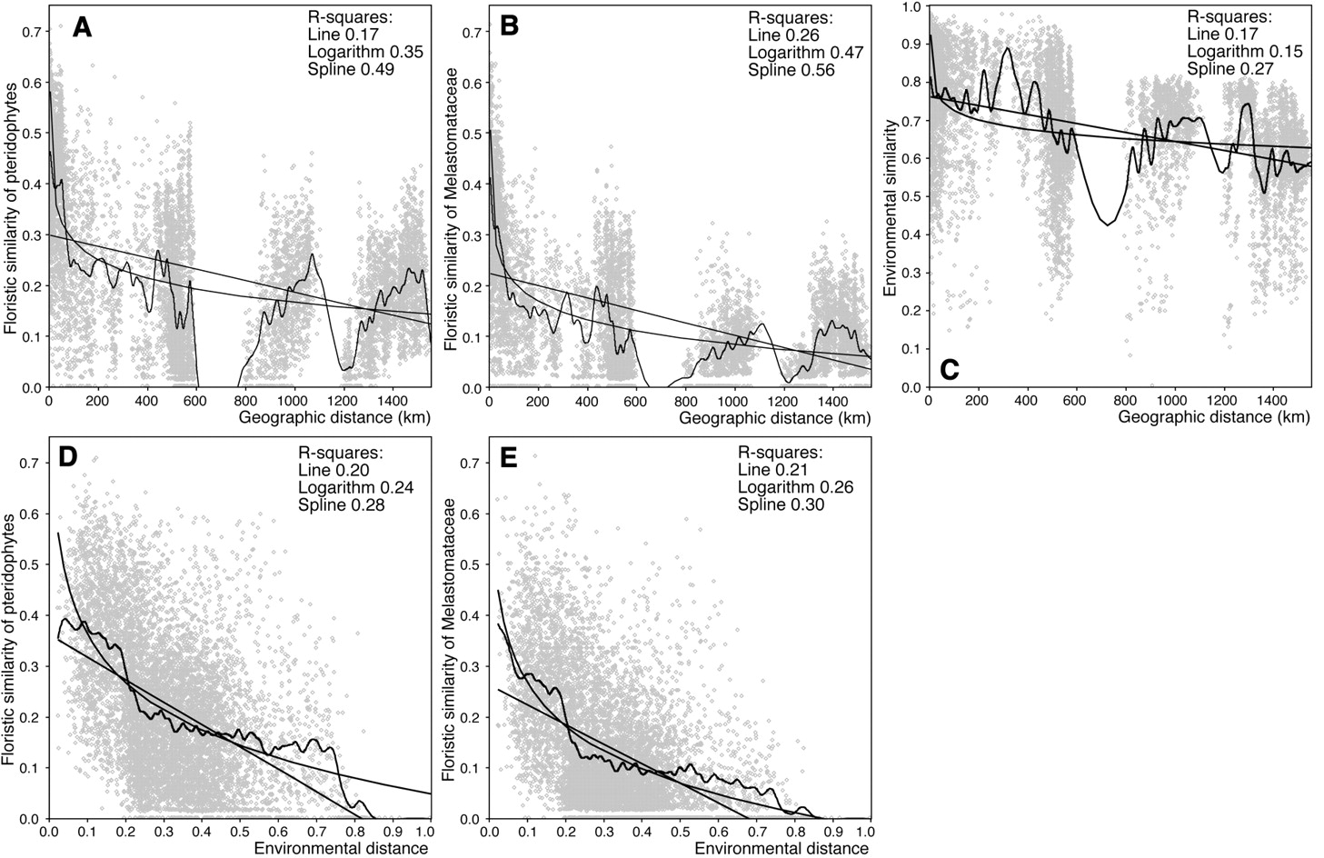
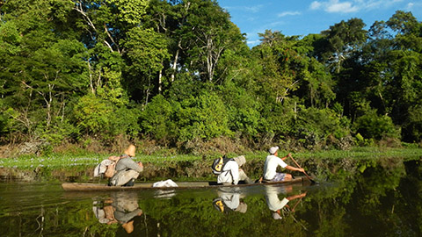


Slide 27
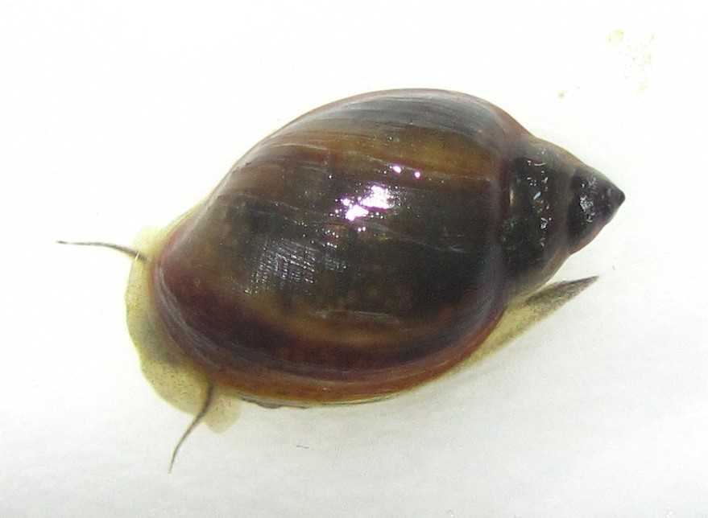
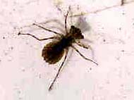
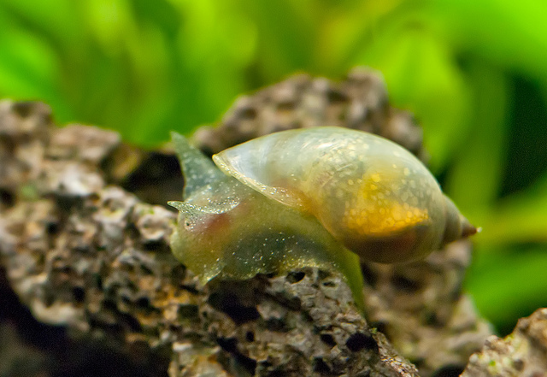
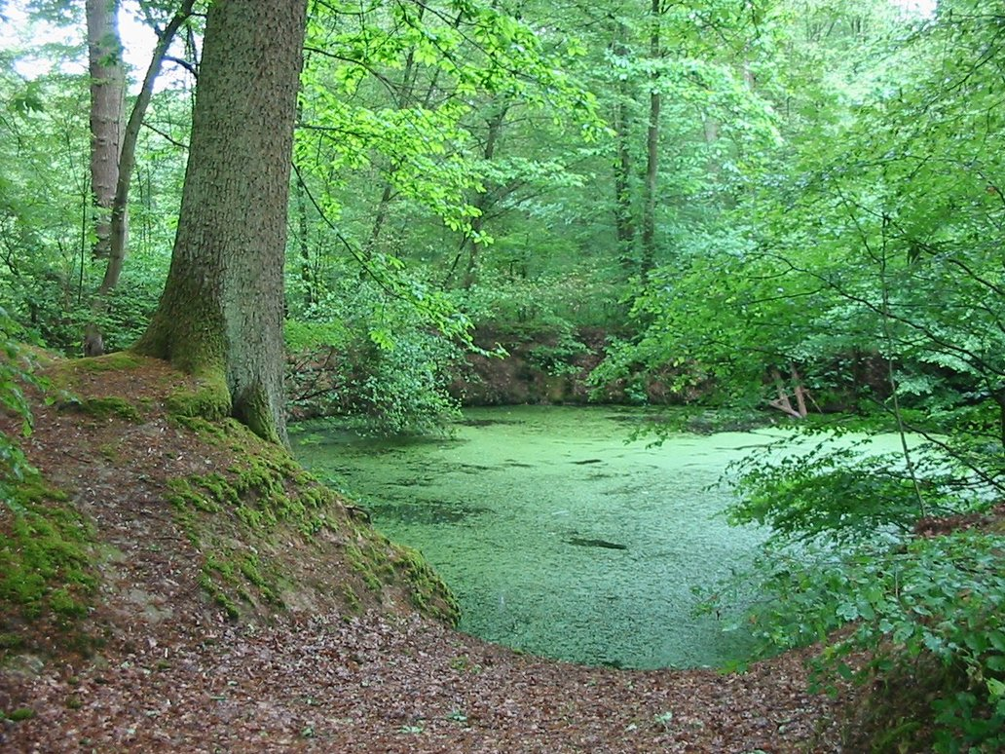
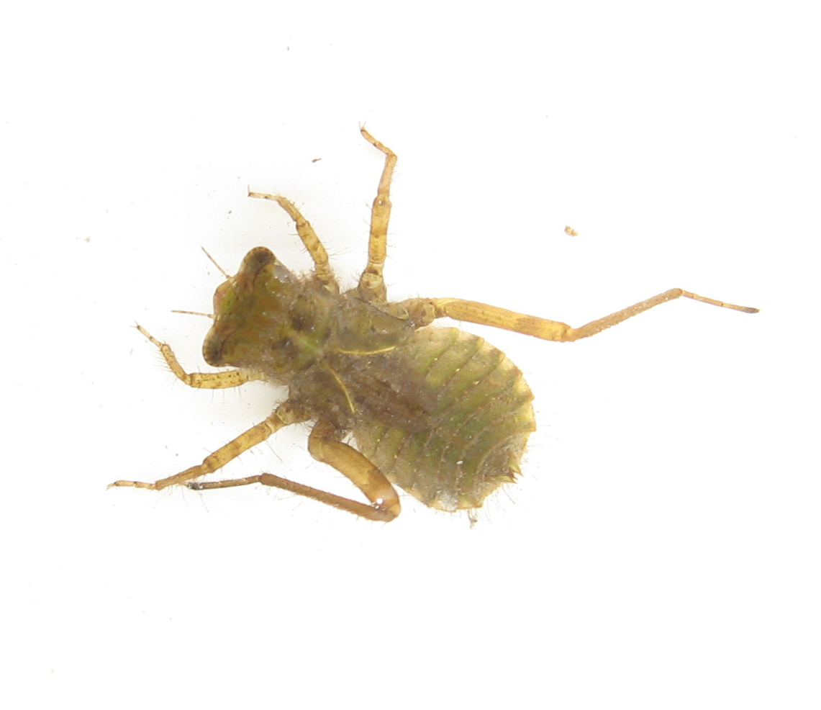
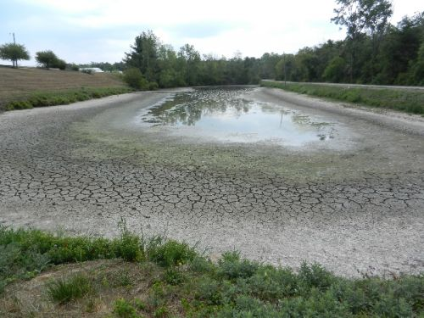
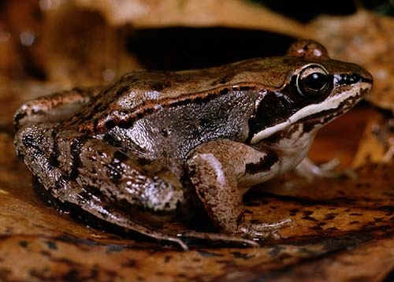
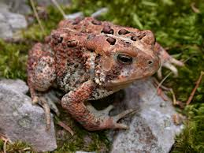
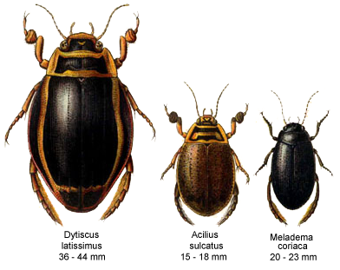
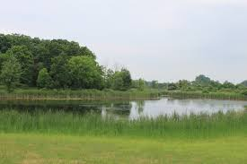
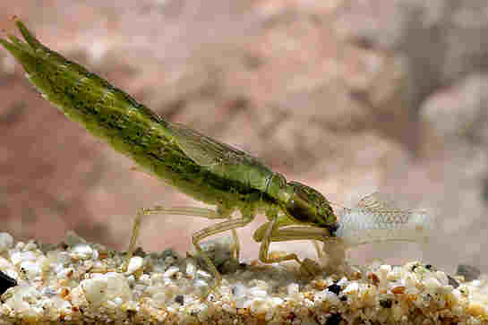
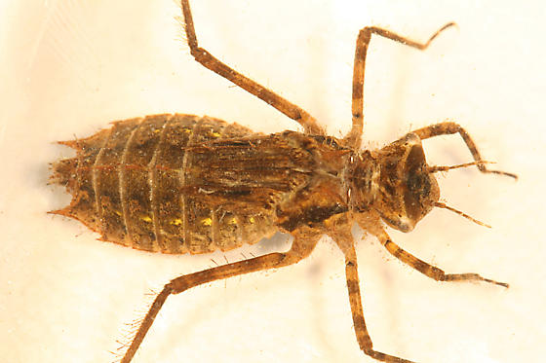
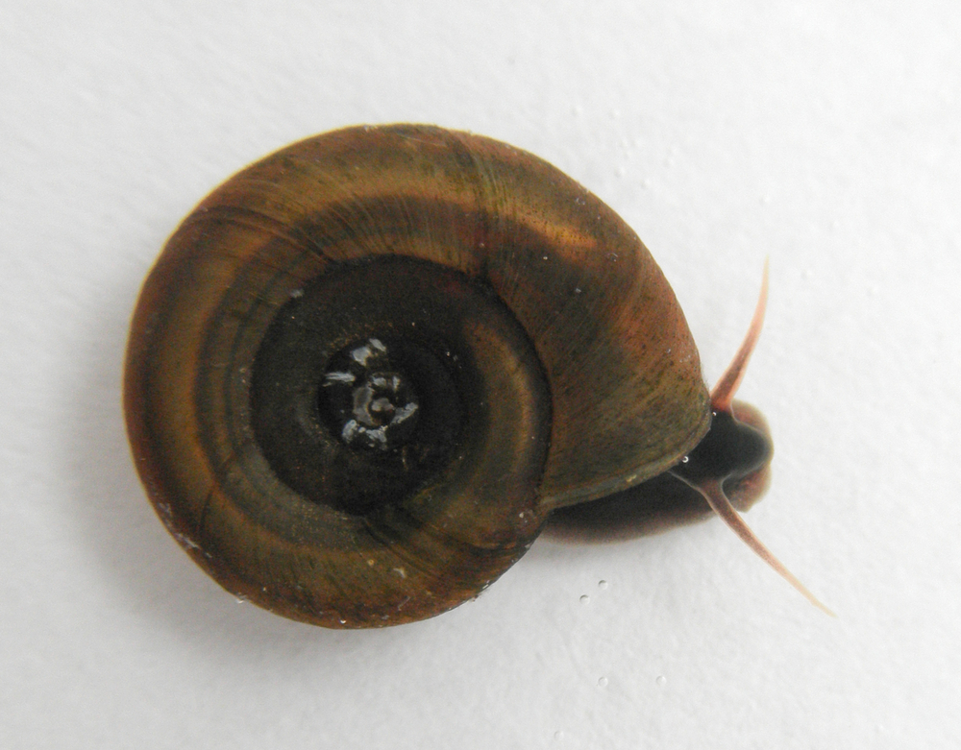
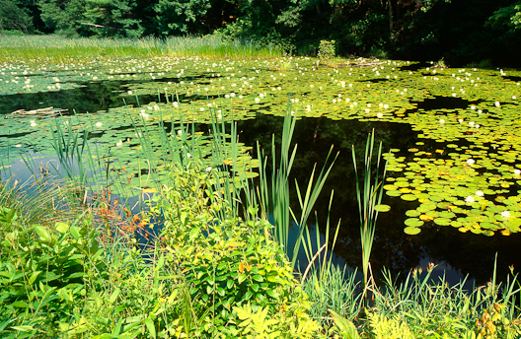
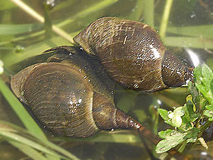
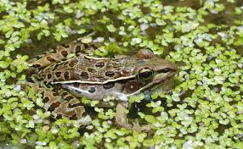
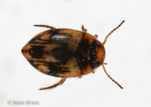
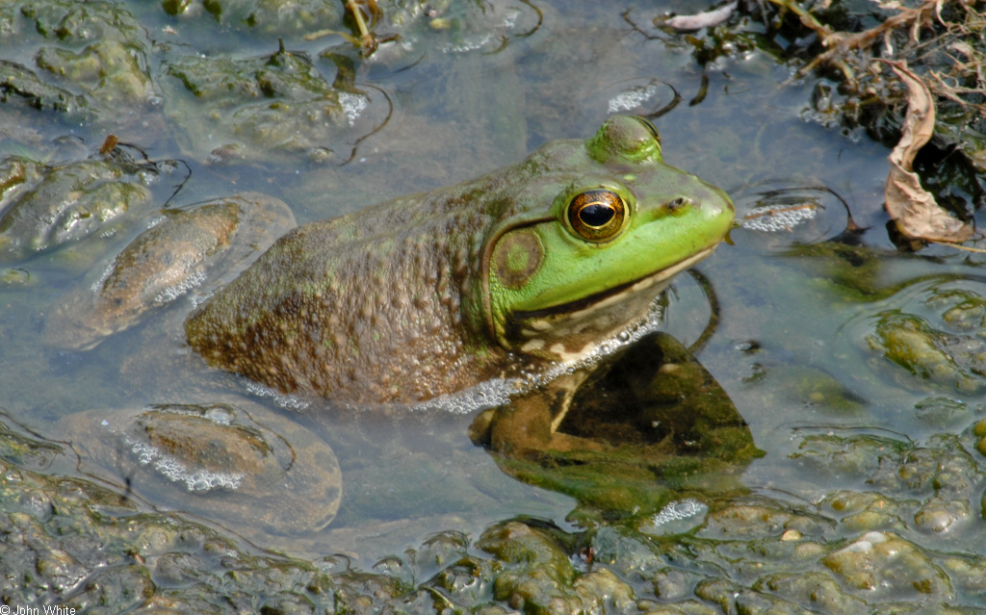
Small Freshwater Ponds—Niche Reigns Supreme

Slide 28
Small Freshwater Ponds—Niche Reigns Supreme
1
0.75
0.5
0.25
0
1
0.75
0.5
0.25
0
Compositional Similarity (Jaccard’s)
Compositional Similarity (Jaccard’s)
0 50 100 150 200 250 300 350 400 450
0 0.1 0.2 0.3 0.4 0.5 0.6 0.7 0.8 0.9 1.0
Spatial Distance (m)
Environmental Distance

Slide 29


Partitioning the variation of β-diversity
(Legendre, Borcard, Peres-Neto, et al).
β-diversity structure
Spatial/Environmental structure

Slide 30

Patterns on BCI and Ponds are at the extremes
Ponds
BCI

Slide 31

A lot of unexplained variation—drift (?), unmeasured?
‘Unexplained variation’
Leibold and Chase 2017

Slide 32




Is Neutral Theory More Prevalent in the Tropics??

Slide 33


Patterns on BCI and Small Ponds are at the extremes
….But are they structured by different processes??
Somewhere in the middle
(Synthesis v.1)
Environment (≈ niche)
BCI
Space (≈ dispersal)
Michigan Ponds
Residuals (≈ drift + unmeasured)
Cottenie 2005, Ecol. Lett
Leibold & Chase 2017

Slide 34
Small plot➔
Lower Heterogeneity
Large plot➔Higher Heterogeneity
Environment
Residuals, Space
Environment
Residuals, Space

Slide 35







Comparing ponds vs. BCI: Metacommunity Scale Mismatch
~10,000-500,000 individuals
~250,000 individuals
~10,000,000-500,000,000 individuals
~390,000,000 individuals
Fricker et al. 2012, Remote Sens, 4(6))

Slide 36
Habitat Associations are Stronger at Larger Scales on BCI
Tabebuia guayacan
Jacaranda copaia
Oenocarpus mapora
Attalea butyracea
Garzon-Lopez et al. 2014. J. Veg Sci

Slide 37
Scale→Community Assembly (Synthesis v. 2)
Environment
Dispersal
Environment (≈ niche)
Space (≈ dispersal)
Residuals (≈ drift + unmeasured)
Viana and Chase 2019

